Slide 1
Data Analytics Project on Medical Apps on Google play store
BY
MEMBERS OF GROUP ONE

Slide 2
Introduction
The dataset presented is a comprehensive dataset gotten from Kaggle, which consist of various applications on the Google play store, but the need to pick a niche was of great importance. So the team decided to concentrate on the medical aspect of App development to help our employers (Medical app developers) to understand how users interact with medical application to create more effective application which can be beneficial to not just the users, but also to Medical facilities with Applications on Google play store.
The reason for this choice was prompted by the need to know the profit margin, the kind of individuals who make use of different medical applications, the rating, reviews of different applications gotten, version compatibility with different devices that helps the developer(s) to know in what direction he/she should go when creating a medical application.

Slide 3
PIPELINe Development
Importation of Dataset(googleplay_store)
To
Jupyter notebook for cleaning with python. with python
Converted Dataset to .CSV file
Business question were developed, analyzed and answered , each analyzed business question were saved as .csv file(s)
THE Datasets were imported to PostgreSQL (PGadmin), where they were queried.
The business questions were then imported to Tableau for visualization and drawing of inference(s).

Slide 4
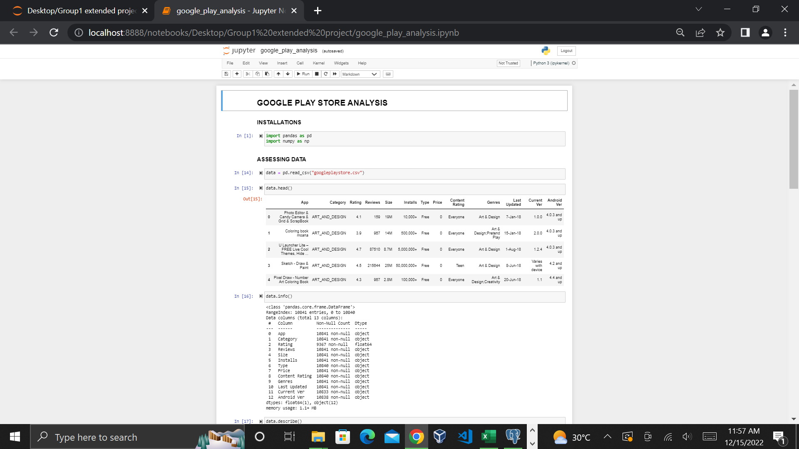
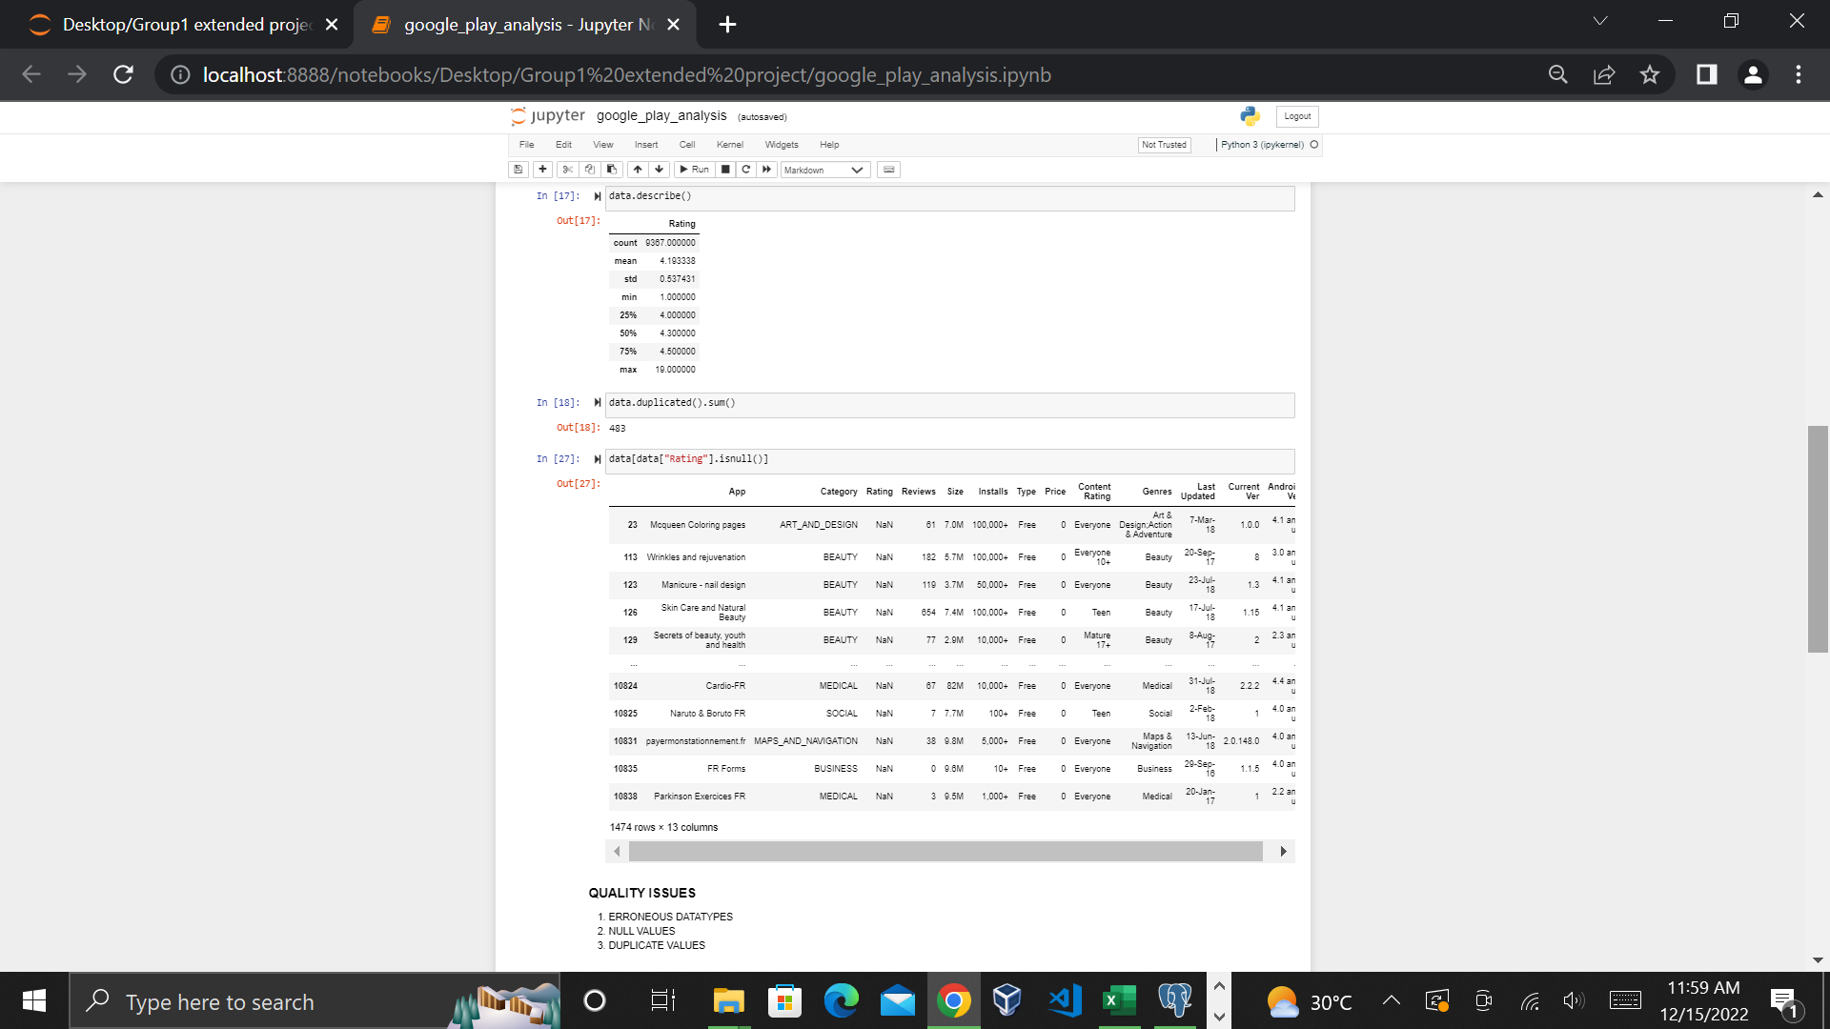
DATA-CLEANING PROCESS WITH python

Slide 5
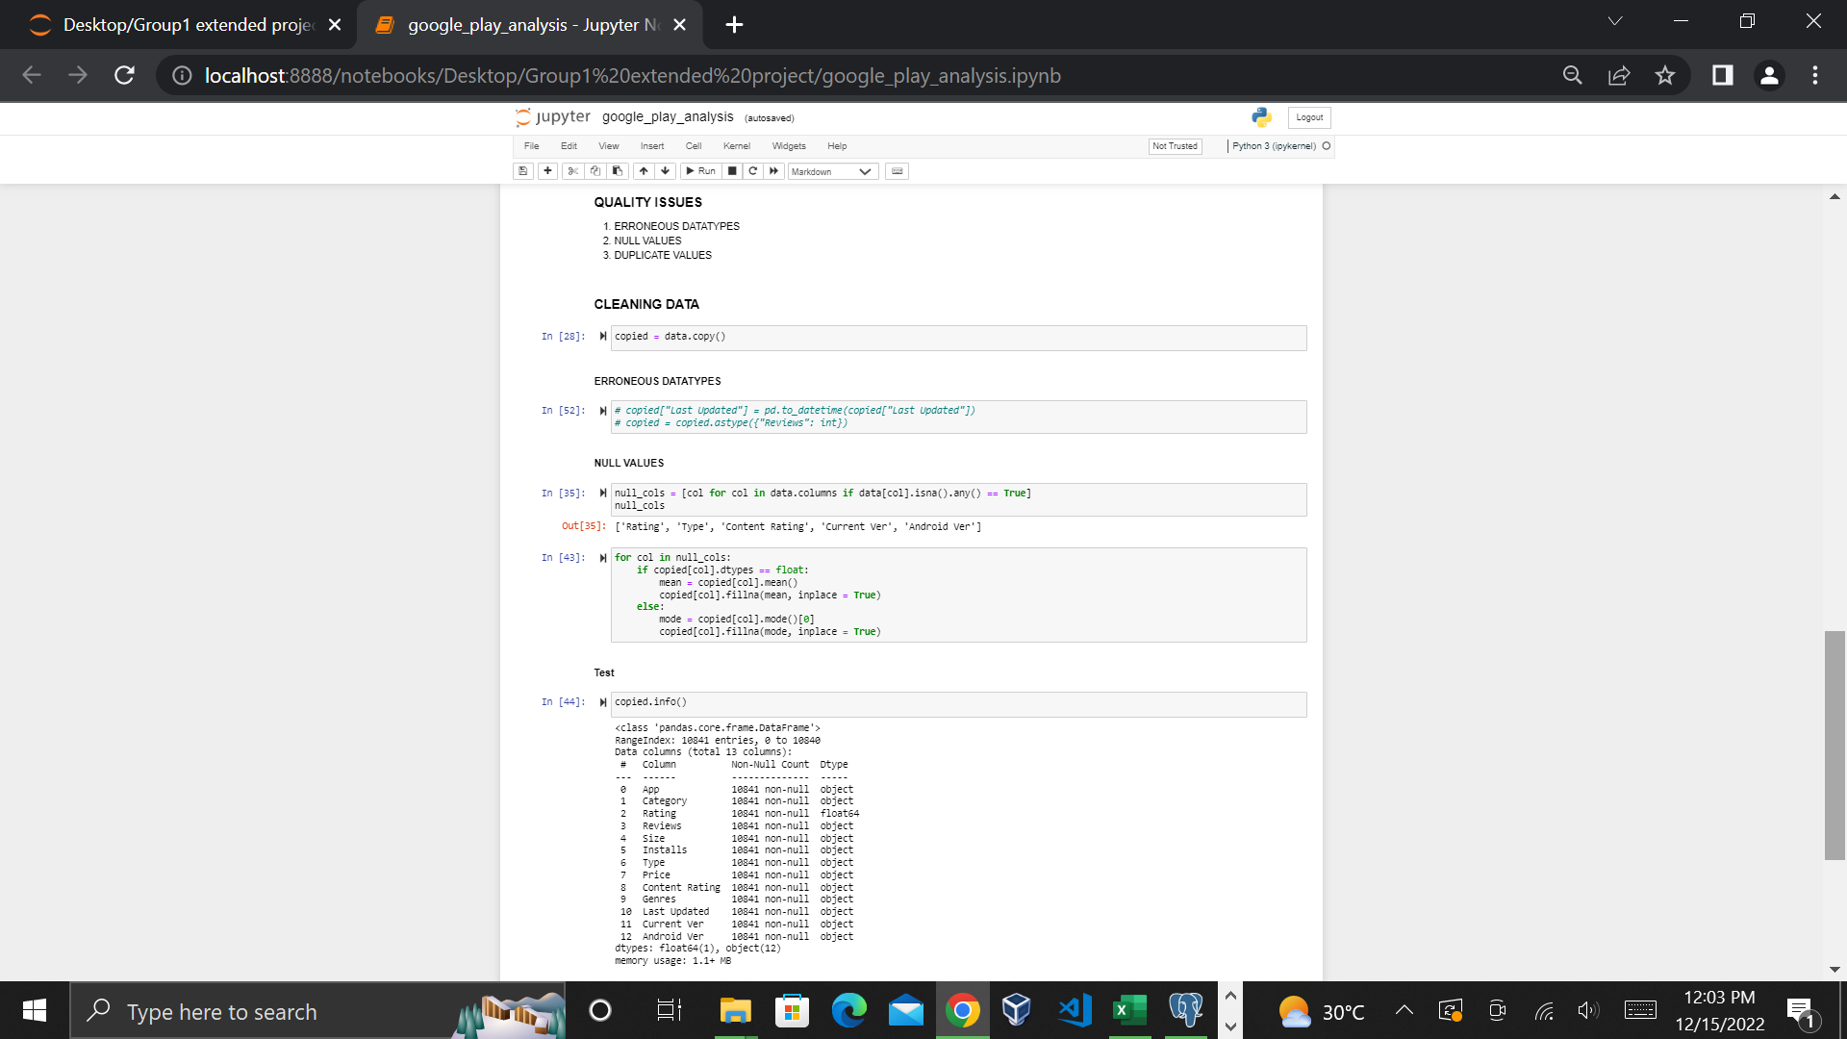
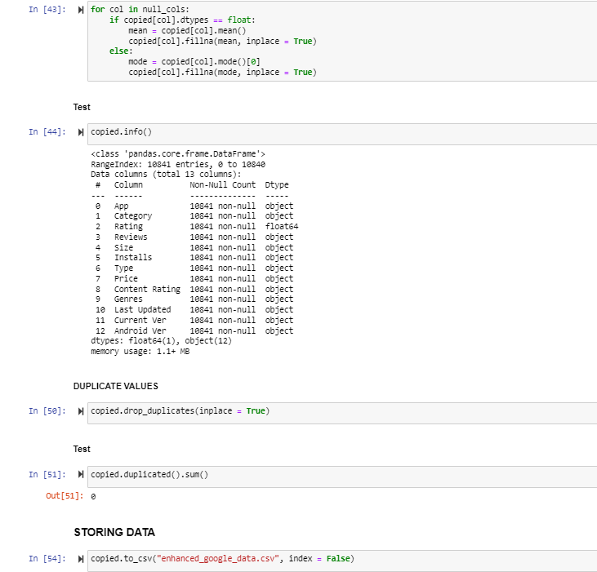
DATA-CLEANING PROCESS WITH PYTHON

Slide 6
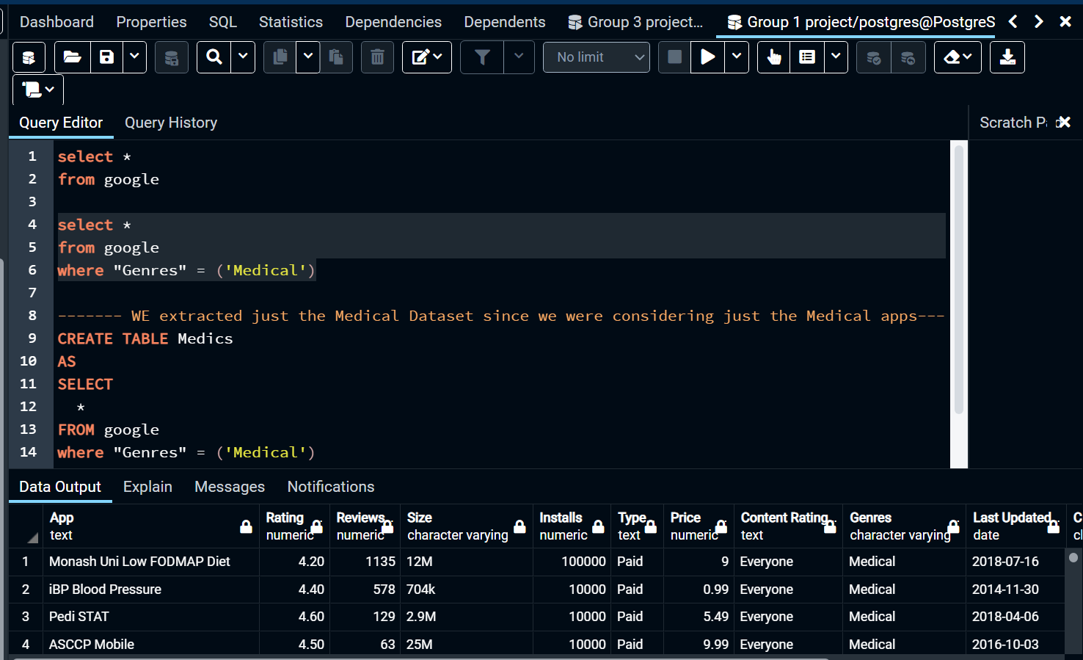
ANSWERING OF BUSINESS QUESTIONS WITH POSTGRESQL
Firstly a database was created and named “google play_store”
A table was then created under the database titled “google”
The table was queried and limited our search to just the medical Apps.
A new table was created from the result of our query and named it “Medics”

Slide 7
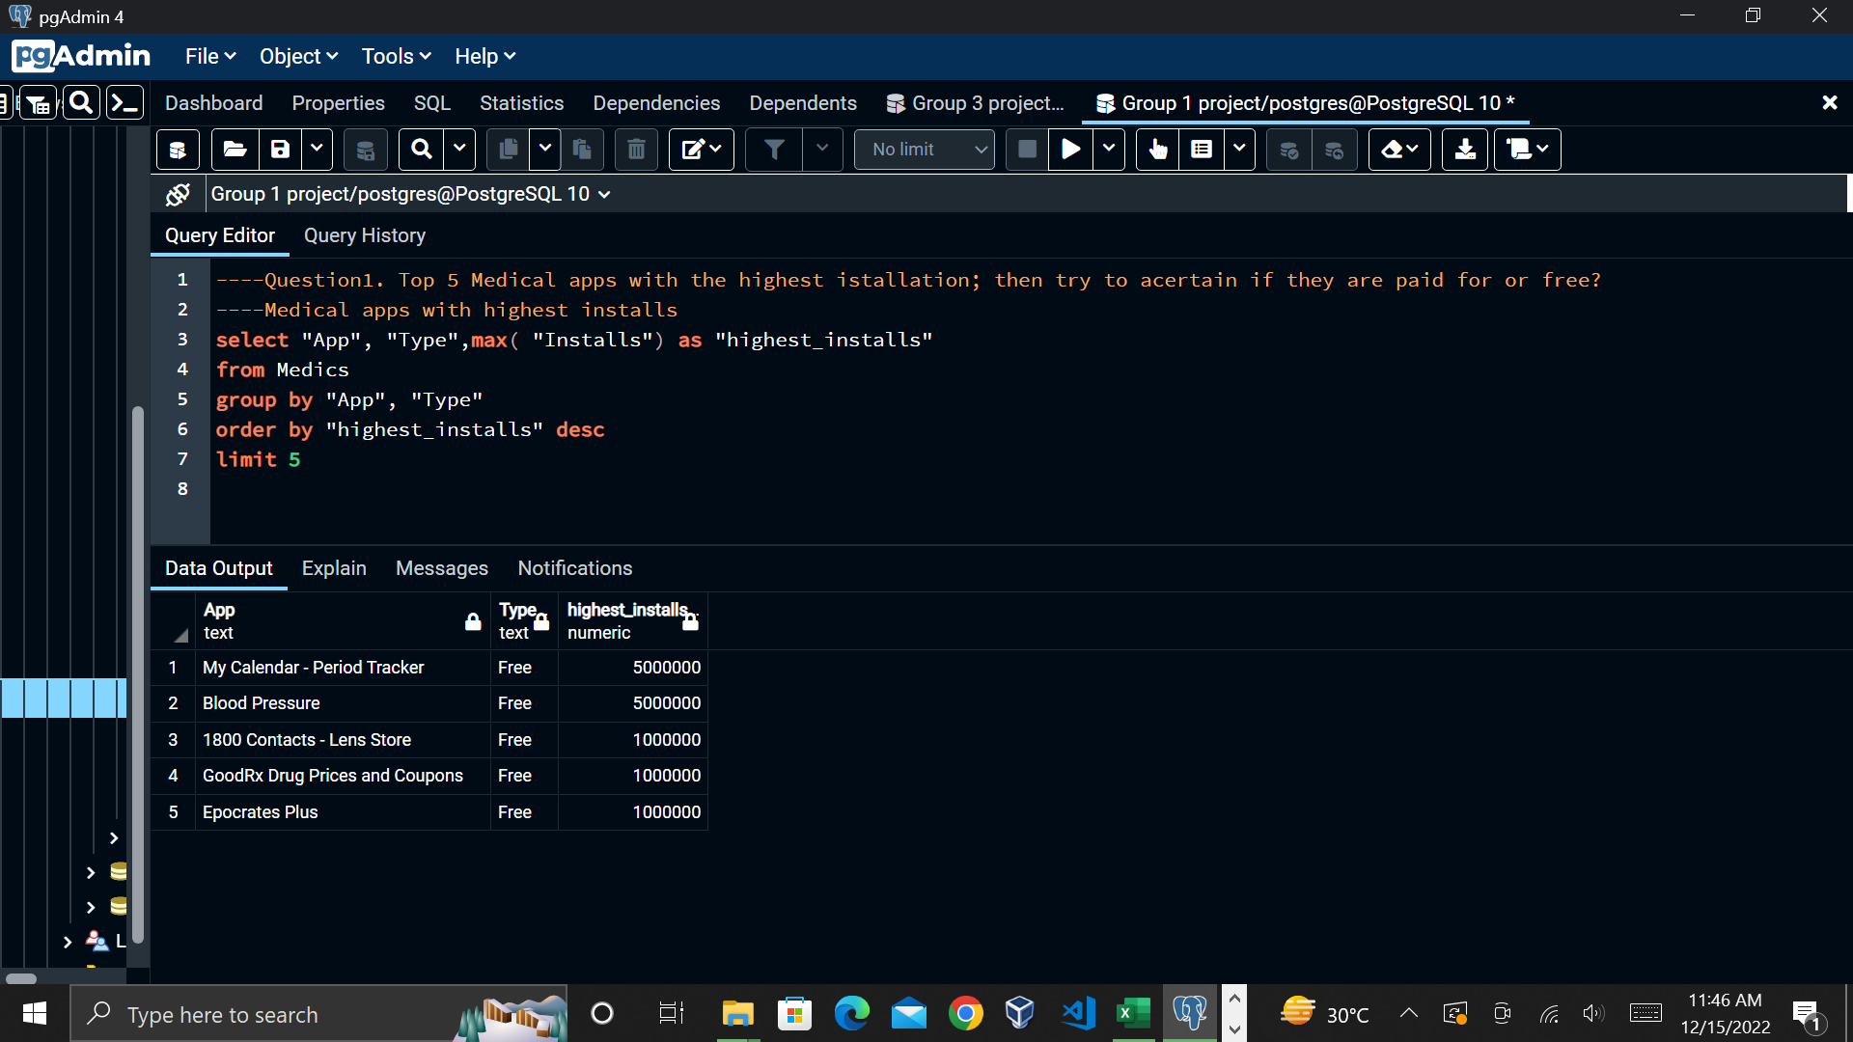
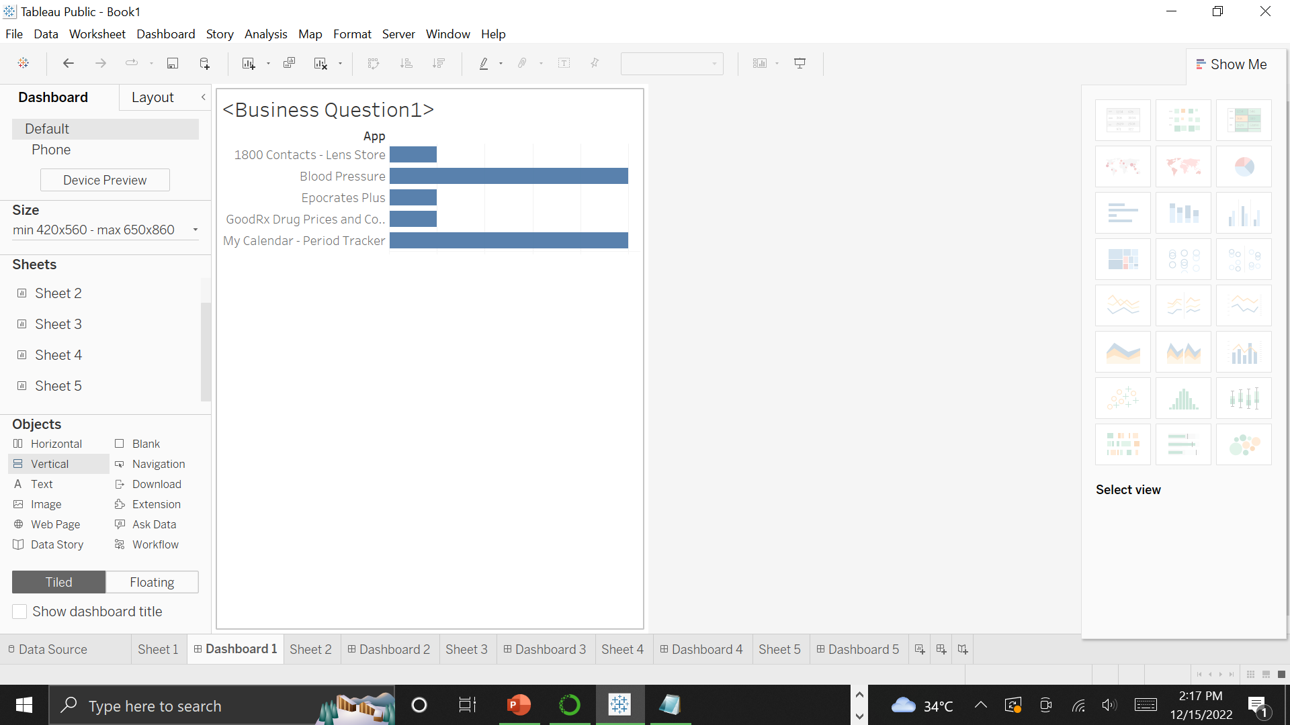
The first business question was analyzed and answered as seen

Slide 8
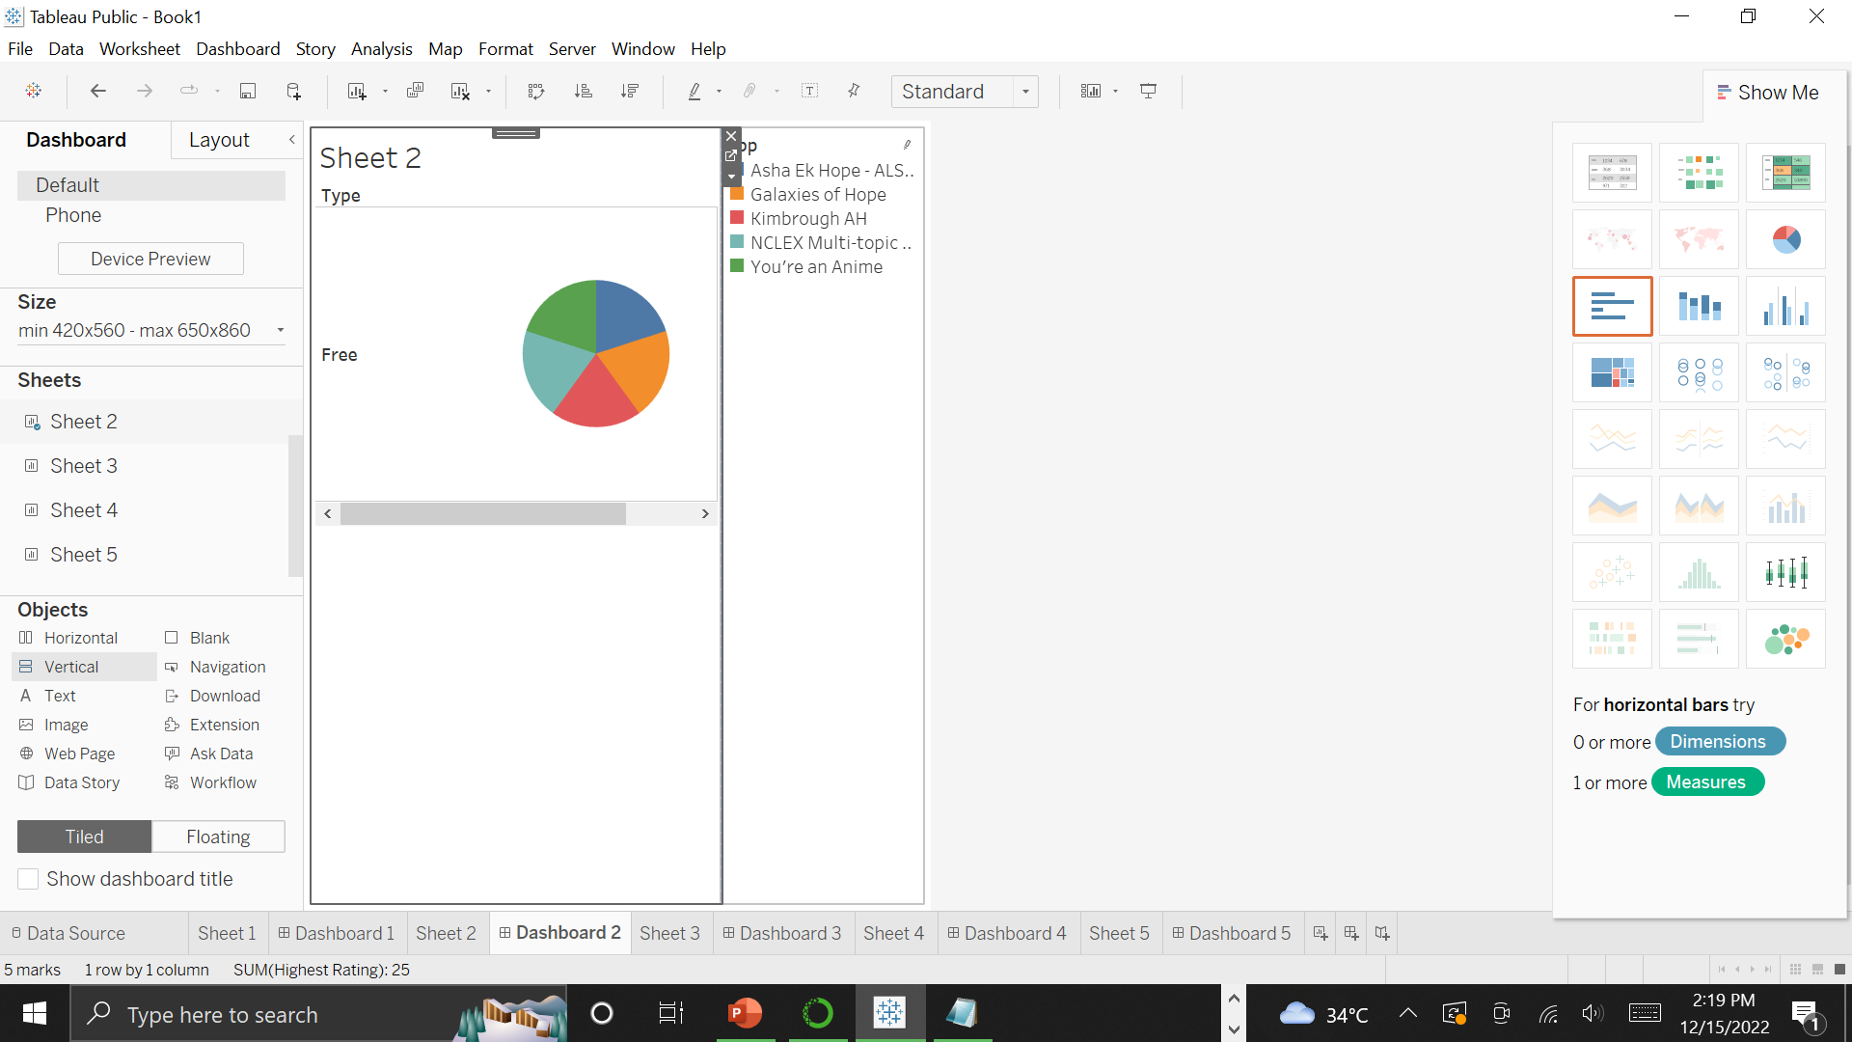
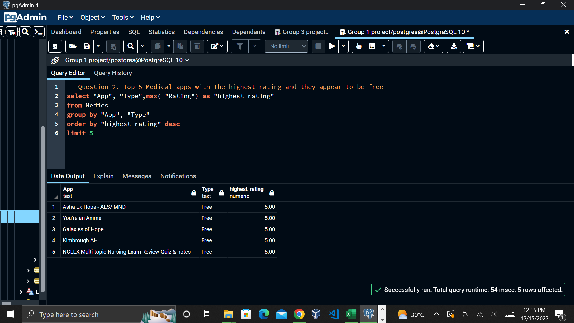
The second business question was analyzed and answered as seen.

Slide 9
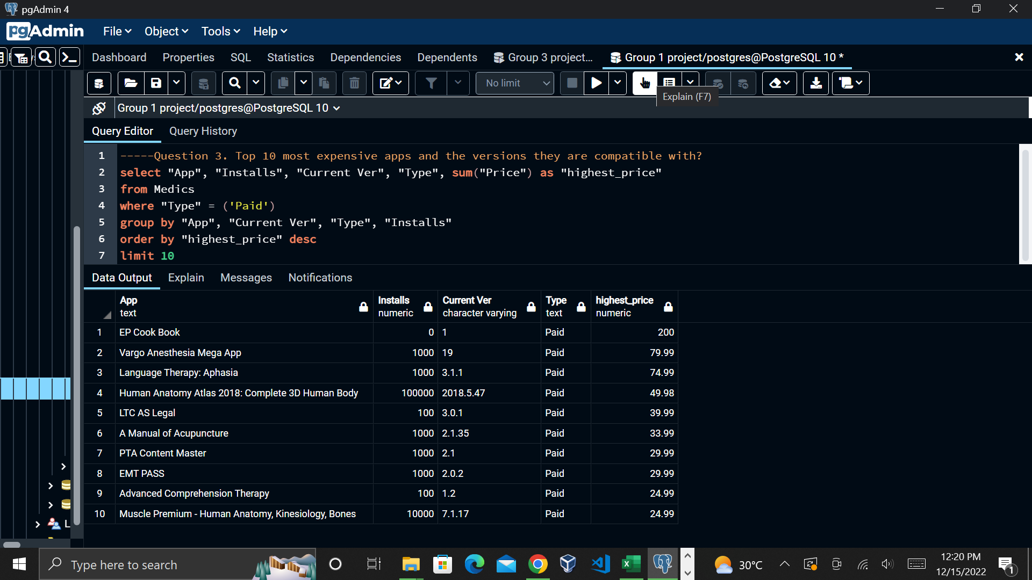
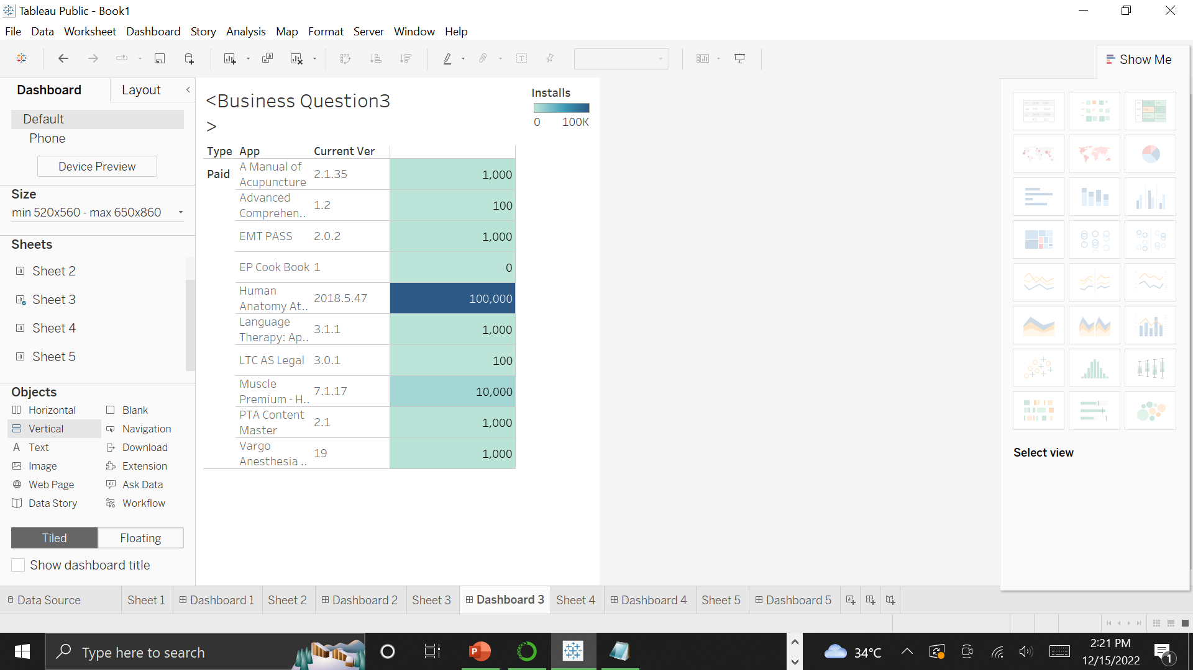
The Third business question was analyzed and answered as seen.

Slide 10
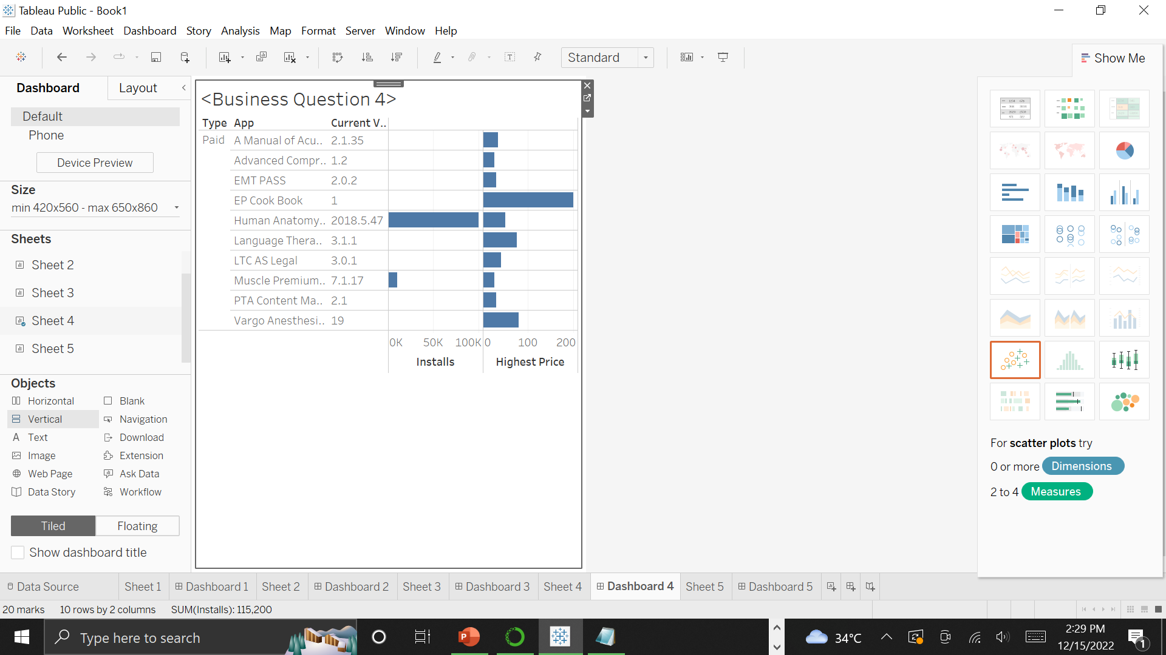
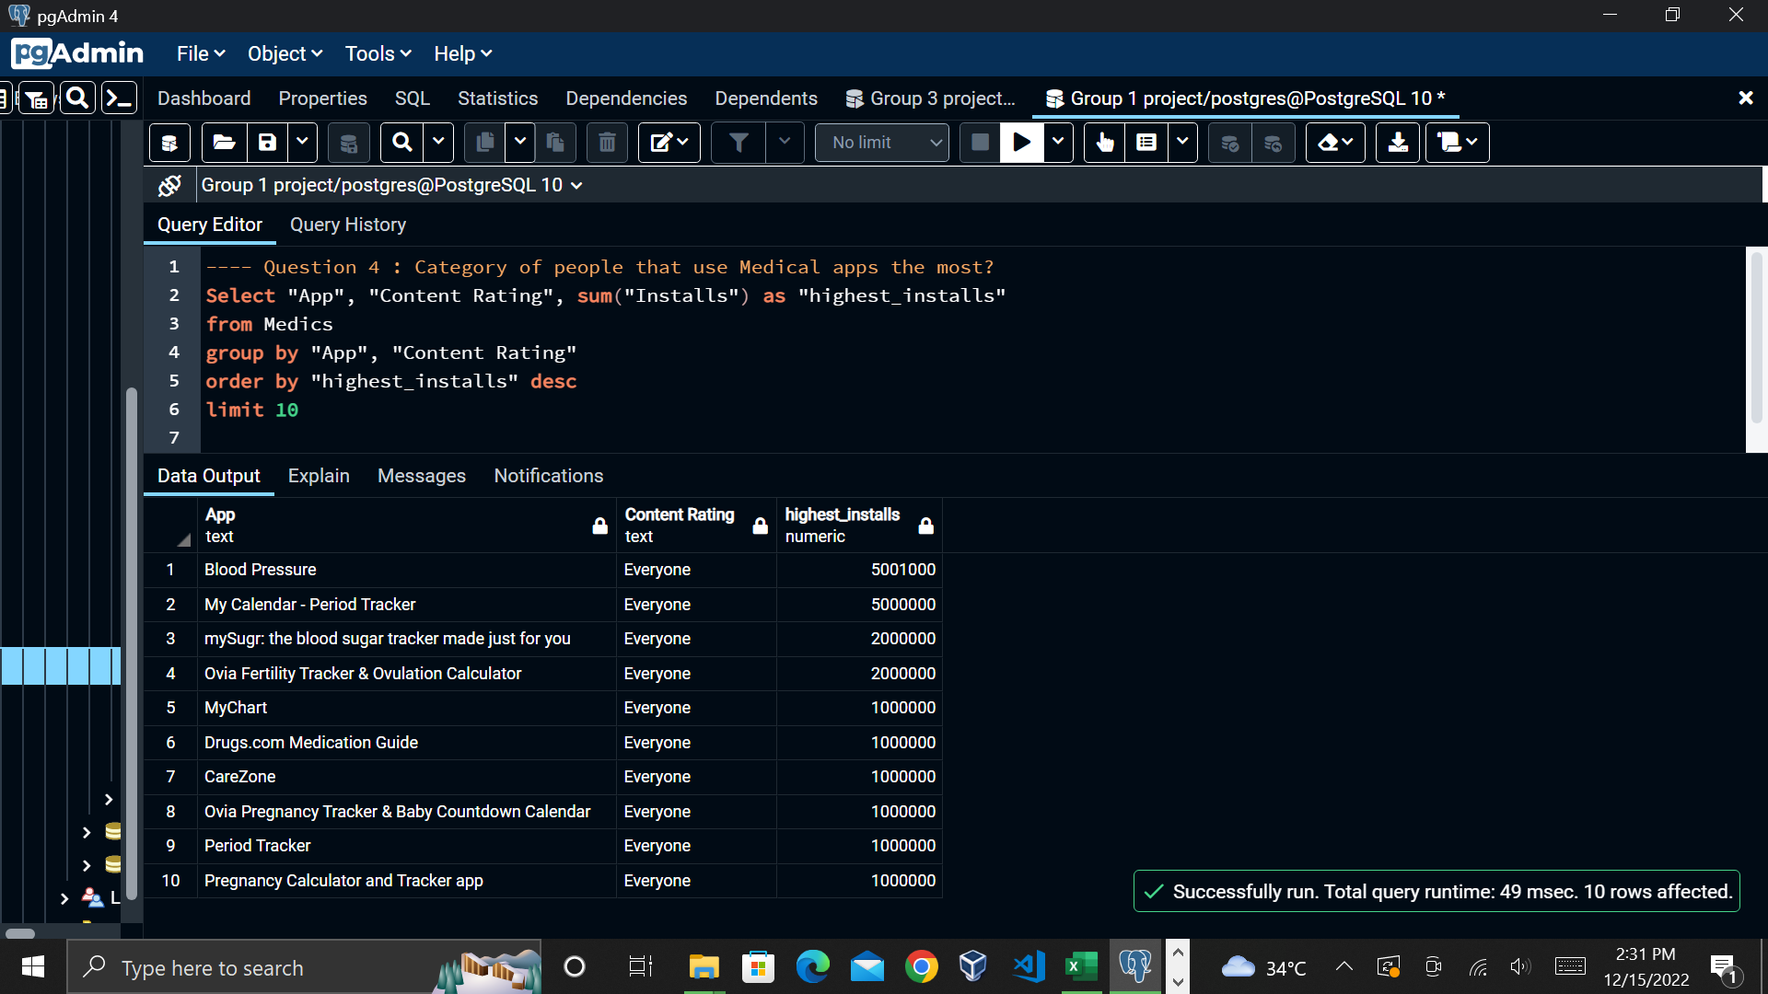
The fourth business question was analyzed and answered as seen.

Slide 11
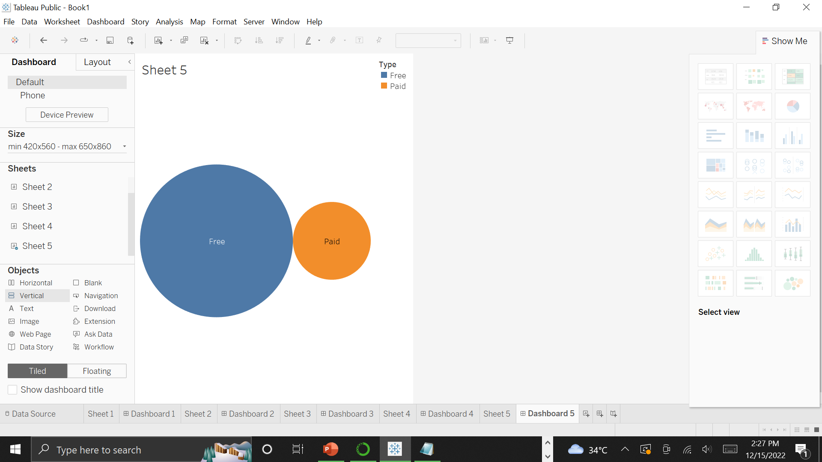
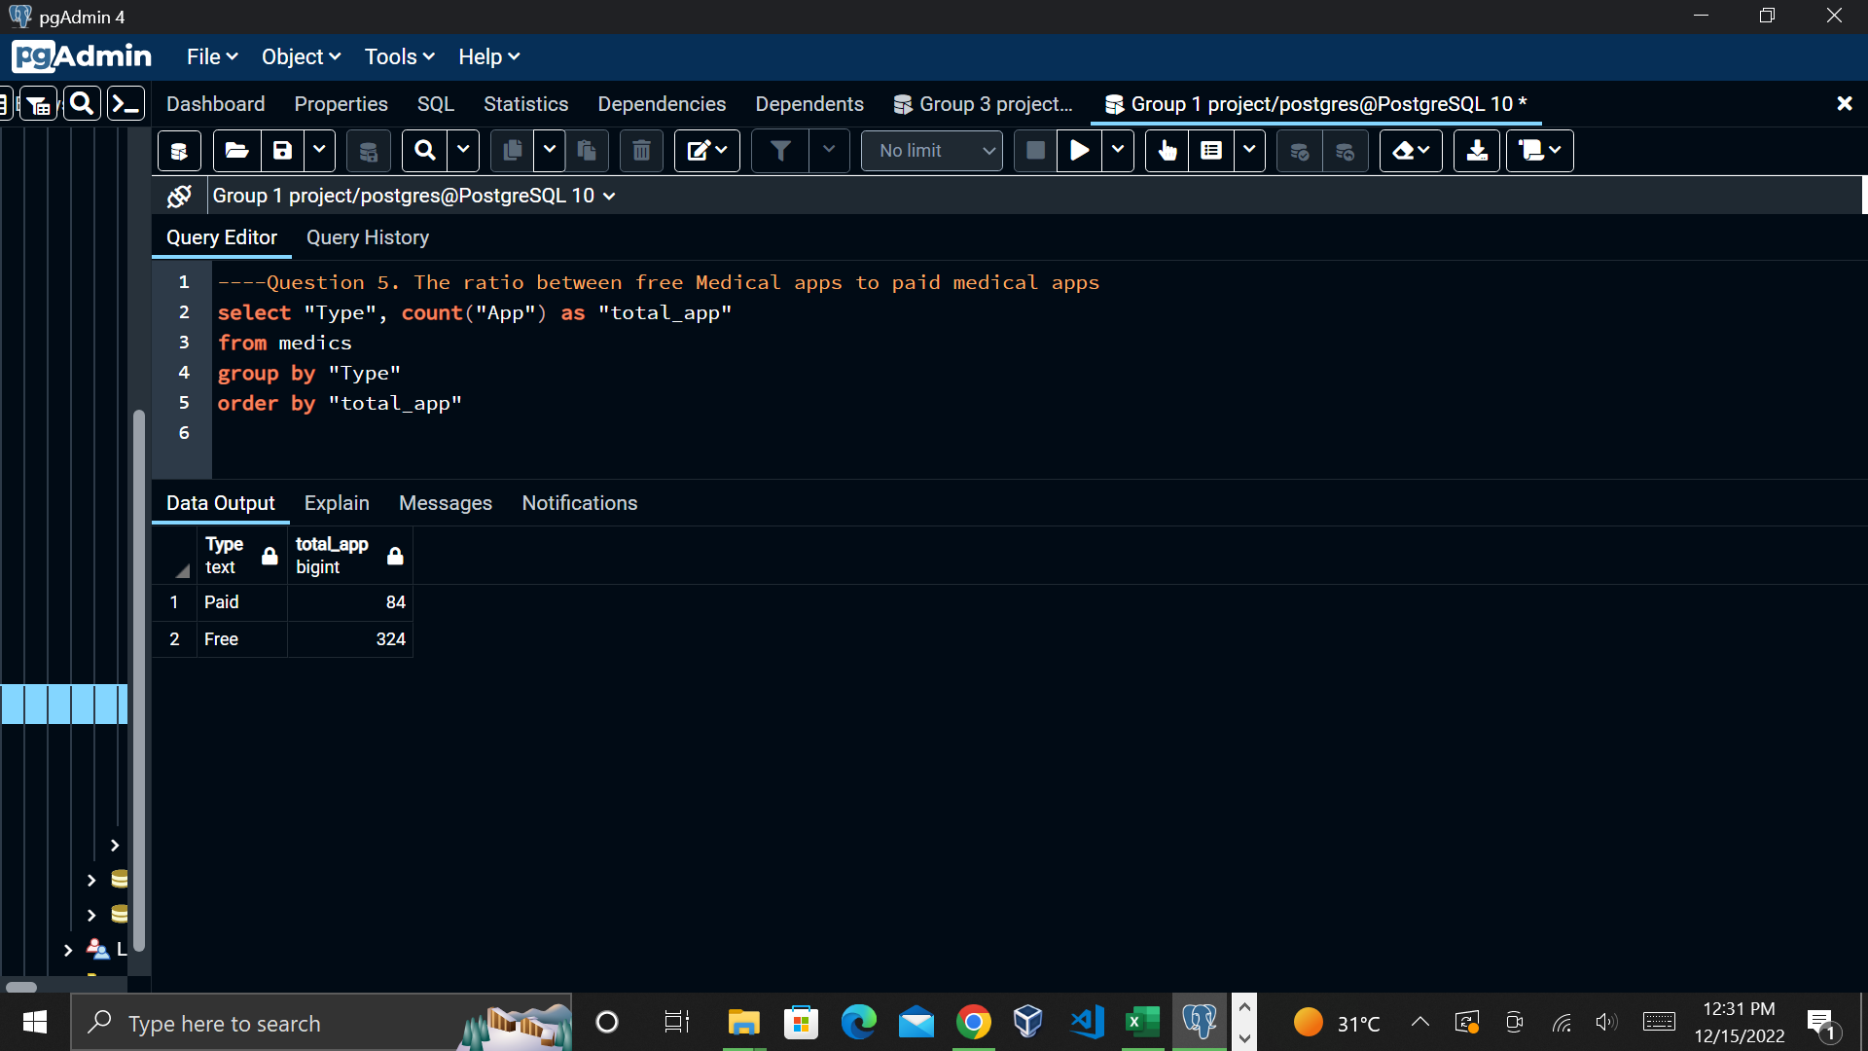
The fifth business question was analyzed and answered as seen.

Slide 12
Thank you for listening ☹☺

